Slide 1
Database Concepts

Slide 2
SQL
SQL (Structured Query Language) is a standard database programming language used for accessing and manipulating data in a database.
The relational model is the theoretical basis of relational databases, which is a technique or way of structuring data using relations, which are grid-like mathematical structures consisting of columns and rows
Database schema
Relation
Attribute
Domain
Tuple

Slide 3
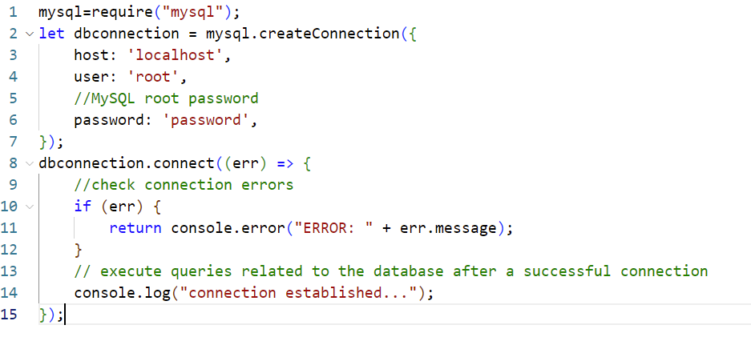
Connecting to MySQL

Slide 4
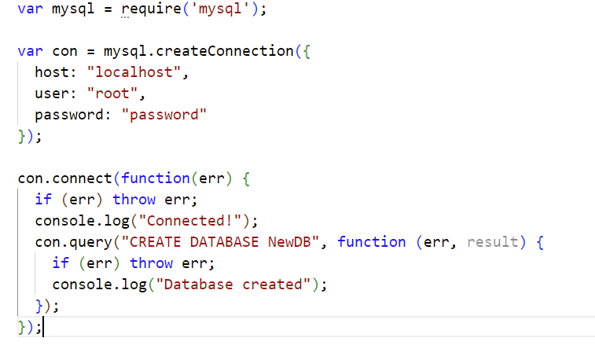
Creating Database
The SQL CREATE DATABASE Statement is used to create a new database

Slide 5
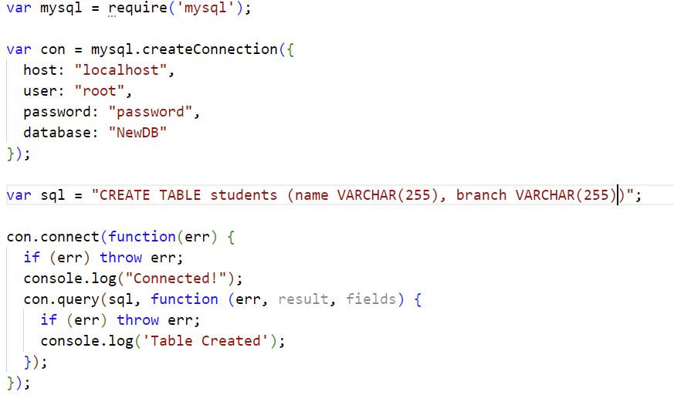
Create Table

Slide 6
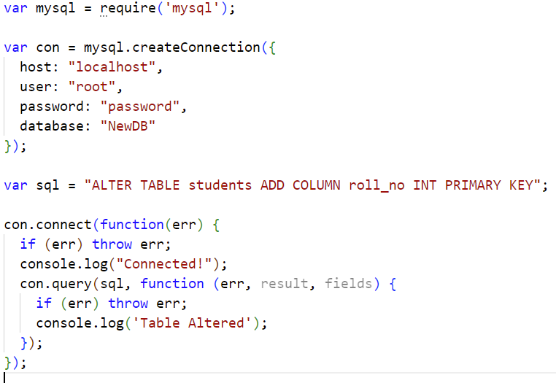
ALTER Table
Notes:
var sql = "CREATE TABLE students (name VARCHAR(255), branch VARCHAR(255), roll_no VARCHAR(12))";
//var sql = "ALTER TABLE students ADD COLUMN id INT AUTO_INCREMENT";
//var sql = "ALTER TABLE students add primary key (roll_no)";
//var sql = "DROP TABLE students";

Slide 7
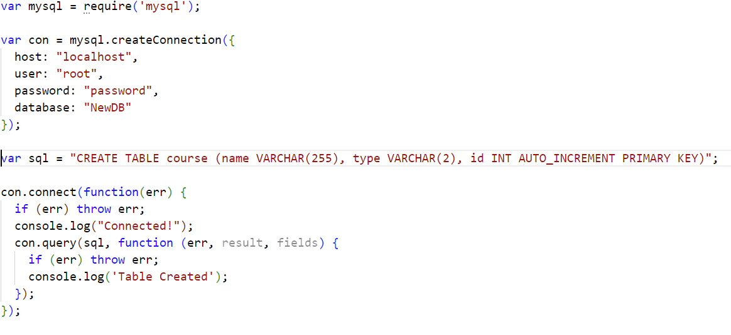

Slide 8
Constraints
The following constraints are commonly used in SQL:
NOT NULL - Ensures that a column cannot have a NULL value
UNIQUE - Ensures that all values in a column are different
PRIMARY KEY - A combination of a NOT NULL and UNIQUE. Uniquely identifies each row in a table
FOREIGN KEY - Prevents actions that would destroy links between tables
CHECK - Ensures that the values in a column satisfies a specific condition
DEFAULT - Sets a default value for a column if no value is specified
CREATE INDEX - Used to create and retrieve data from the database very quickly

Slide 9
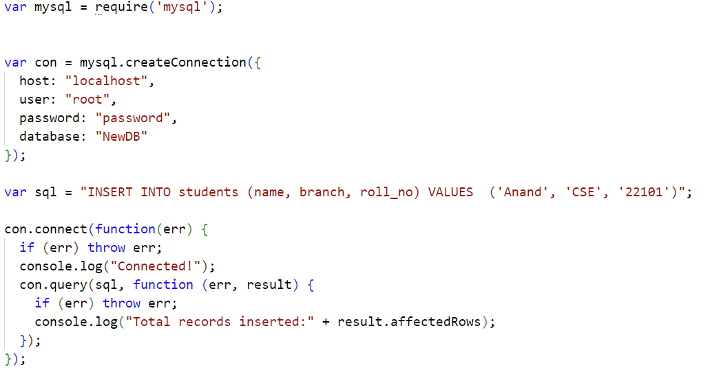

Slide 10
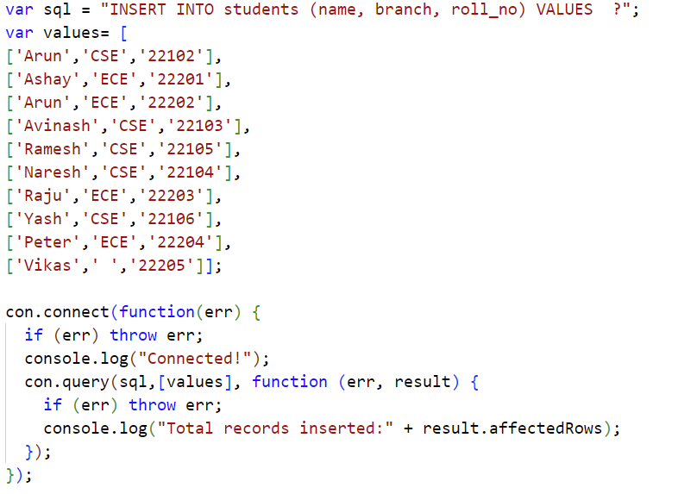

Slide 11
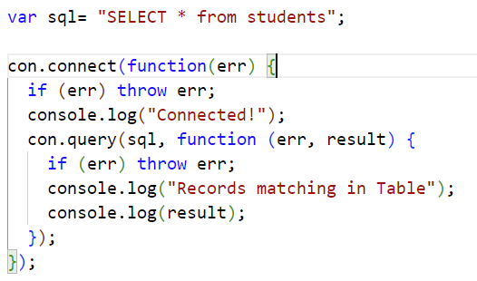
SELECT
var sql= "SELECT name, branch from students";

Slide 12
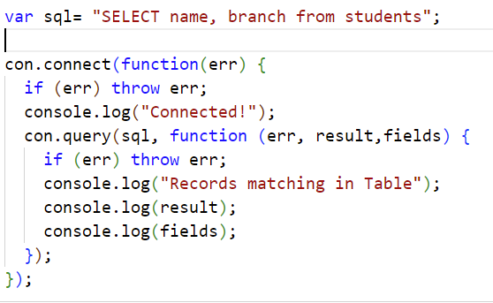
var sql= "SELECT name, roll_no from students WHERE branch='CSE'";

Slide 13
var sql= "SELECT name, roll_no from students WHERE branch=‘ECE' ORDER BY roll_no";
var sql= "SELECT name, roll_no from students WHERE branch='CSE' ORDER BY NAME DESC";

Slide 14
var sql= “DELETE from students WHERE roll_no=‘22201';
var sql= “DROP TABLE students”;

Slide 16
var sql= "SELECT name, roll_no from students WHERE branch='CSE' LIMIT 4 ";
var sql= "SELECT name, roll_no from students WHERE branch='CSE' LIMIT 4 OFFSET 2";

Slide 17
FOREIGN KEY
var sql = "CREATE TABLE course_reg(course_reg_no INT AUTO_INCREMENT PRIMARY KEY, student_id INT, course_id INT,CONSTRAINT FK_StudentID FOREIGN KEY(student_id) REFERENCES students(roll_no), CONSTRAINT FK_Course_reg FOREIGN KEY(course_id) REFERENCES course(id))";

Slide 18
Join Two or More Tables
You can combine rows from two or more tables, based on a related column between them, by using a JOIN statement.
INNER JOIN:
Returns records that have matching values in both tables
var sql= "SELECT * FROM ((course_reg INNER JOIN students ON course_reg.student_id=students.roll_no) INNER JOIN course ON course_reg.course_id=course.id)";

Slide 19
Join Two or More Tables
You can combine rows from two or more tables, based on a related column between them, by using a JOIN statement.
LEFT JOIN:
Returns all records from the left table, and the matched records from the right table
var sql= "SELECT * FROM ((course_reg LEFT JOIN students ON course_reg.student_id=students.roll_no) LEFT JOIN course ON course_reg.course_id=course.id)";

Slide 20
Join Two or More Tables
You can combine rows from two or more tables, based on a related column between them, by using a JOIN statement.
RIGHT JOIN:
Returns all records from the right table, and the matched records from the left table
var sql= "SELECT * FROM ((course_reg RIGHT JOIN students ON course_reg.student_id=students.roll_no) RIGHT JOIN course ON course_reg.course_id=course.id)";
TRY OUT:
CROSS JOIN ?
SELF JOIN ?

Slide 21
Views
In SQL, a view is a virtual table based on the result-set of an SQL statement.
A view contains rows and columns, just like a real table. The fields in a view are fields from one or more real tables in the database.
var sql1=" CREATE VIEW CSE_students AS SELECT name, roll_no FROM students WHERE branch = 'CSE' ";
var sql2="SELECT * FROM CSE_students"

Slide 22
INDEXING
Indexing is a way to optimize the performance of a database by minimizing the number of disk accesses required when a query is processed.
Pros:
Faster data retrieval
Quicker Unique Queries
Ideal Choice for Online Analytical Processing (OLAP)

Slide 23
INDEXING
"SELECT * from course where type='PC’”
EXPLAIN SELECT * from course where type='PC’

Slide 24
INDEXING
"SELECT * from course where type='PC’”
EXPLAIN SELECT * from course where type='PC’
CREATE INDEX ctype ON course(type)
EXPLAIN SELECT * from course where type='PC’

Slide 25
References
https://www.cs.utexas.edu/~mitra/csSummer2022/hsra/lectures/sql.html
"Fundamentals of ""DATABASE SYSTEMS," Fifth Edition Ramez Elmasri, "University of Texas at Arlington" Shamkant B. Navathe, "Georgia Institute of Technology" ISBN 0-321-36957-2 "

Slide 26
NO SQL
Why NO SQL?
SQL | NoSQL
RELATIONAL DATABASE MANAGEMENT SYSTEM (RDBMS) | Non-relational or distributed database system.
These databases have fixed or static or predefined schema | They have dynamic schema
These databases are not suited for hierarchical data storage. | These databases are best suited for hierarchical data storage.
These databases are best suited for complex queries | These databases are not so good for complex queries
Vertically Scalable | Horizontally scalable
Follows ACID property | Follows CAP(consistency, availability, partition tolerance)

Slide 27
Connecting MongoDB
var MongoClient = require('mongodb').MongoClient;
//Create a database named "mydb":
var url = "mongodb://127.0.0.1:27017/mydb2";
MongoClient.connect(url, function(err, db) {
if (err) throw err;
console.log("Connected and Database created!");
db.close();
});

Slide 28
Creating Collection
var MongoClient = require('mongodb').MongoClient;
var url = "mongodb://127.0.0.1:27017/";
MongoClient.connect(url, function(err, db) {
if (err) throw err;
var dbo = db.db("mydb2");
dbo.createCollection("students", function(err, res) {
if (err) throw err;
console.log("Collection created!");
db.close();
});
});

Slide 29
Inserting into Collection
var MongoClient = require('mongodb').MongoClient;
var url = "mongodb://127.0.0.1:27017/";
MongoClient.connect(url, function(err, db) {
if (err) throw err;
var dbo = db.db("mydb2");
var myobj = [
{ name: 'Arun', address: 'Bangalore', rollno:'22101', branch:'CSE'},
{ name: 'Anand', address: 'Chennai',rollno:'22102', branch:'CSE'}];
dbo.collection("students").insertMany(myobj, function(err, res) {
if (err) throw err;
console.log("Number of documents inserted: " + res.insertedCount);
db.close();
});
});

Slide 30
Deleting from Collection
var MongoClient = require('mongodb').MongoClient;
var url = "mongodb://127.0.0.1:27017/";
MongoClient.connect(url, function(err, db) {
if (err) throw err;
var dbo = db.db("mydb2");
var myquery = { name: 'Harish' };
dbo.collection("students").deleteOne(myquery, function(err, obj) {
if (err) throw err;
console.log(obj.deletedCount+ " document(s) deleted");
db.close();
});
});

Slide 31
Deleting from Collection
var MongoClient = require('mongodb').MongoClient;
var url = "mongodb://127.0.0.1:27017/";
MongoClient.connect(url, function(err, db) {
if (err) throw err;
var dbo = db.db("mydb2");
var myquery = { address: /^B/ };
dbo.collection("students").deleteMany(myquery, function(err, obj) {
if (err) throw err;
console.log(obj.deletedCount+ " document(s) deleted");
db.close();
});
});

Slide 32
Drop Collection
var MongoClient = require('mongodb').MongoClient;
var url = "mongodb://127.0.0.1:27017/";
MongoClient.connect(url, function(err, db) {
if (err) throw err;
var dbo = db.db("mydb2");
dbo.dropCollection("students", function(err, delOK) {
if (err) throw err;
if (delOK) console.log("Collection deleted");
db.close();
});
});

Slide 33
Retrieval and displaying of records
var MongoClient = require('mongodb').MongoClient;
var url = "mongodb://127.0.0.1:27017/";
MongoClient.connect(url, function(err, db) {
if (err) throw err;
var dbo = db.db("mydb2");
var query={branch:/ECE/};
dbo.collection("students").find(query).sort({name:1}).toArray(function(err, result) {
if (err) throw err;
console.log(result);
db.close();
});
});

Slide 34
regex
"(?i)" begins a case-insensitive match.
"(?-i)" ends a case-insensitive match.
{branch:{$not: /^ECE/ }}
{name:{$regex: /^A.*/i}}
var query={branch:{$regex:/C.*/}};
var query={branch:{$regex:/^C.*/}};
find( { description: { $regex: /^S/, $options: 'm' } } )
https://www.mongodb.com/docs/manual/reference/operator/query/regex/

Slide 35
Aggregation
Group values from multiple documents together.
Perform operations on the grouped data to return a single result.
Analyze data changes over time.
db.collection.count()
db.collection.distinct()

Slide 36
var MongoClient = require('mongodb').MongoClient;
var url = "mongodb://127.0.0.1:27017/";
MongoClient.connect(url, function(err, db) {
if (err) throw err;
var dbo = db.db("mydb2");
dbo.collection("students").aggregate([ {$match:{ branch: 'CSE'}}]).toArray(function(err, result)
{
if (err) throw err;
console.log(result);
db.close();
});
});

Slide 37
var MongoClient = require('mongodb').MongoClient;
var url = "mongodb://127.0.0.1:27017/";
MongoClient.connect(url, function(err, db) {
if (err) throw err;
var dbo = db.db("mydb2");
dbo.collection("students").aggregate([ {$match:{ branch: 'CSE'}} , {$group:{ _id:'$address'} }]).toArray(function(err, result)
{
if (err) throw err;
console.log(result);
db.close();
});
});

Slide 38
var MongoClient = require('mongodb').MongoClient;
var url = "mongodb://127.0.0.1:27017/";
MongoClient.connect(url, function(err, db) {
if (err) throw err;
var dbo = db.db("mydb2");
dbo.collection("students").aggregate([ {$match:{ branch: 'CSE'}} , {$group:{ _id:'$address', totalstudents: { $sum:1 }} }]).toArray(function(err, result)
{
if (err) throw err;
console.log(result);
db.close();
});
});

